Slide 1

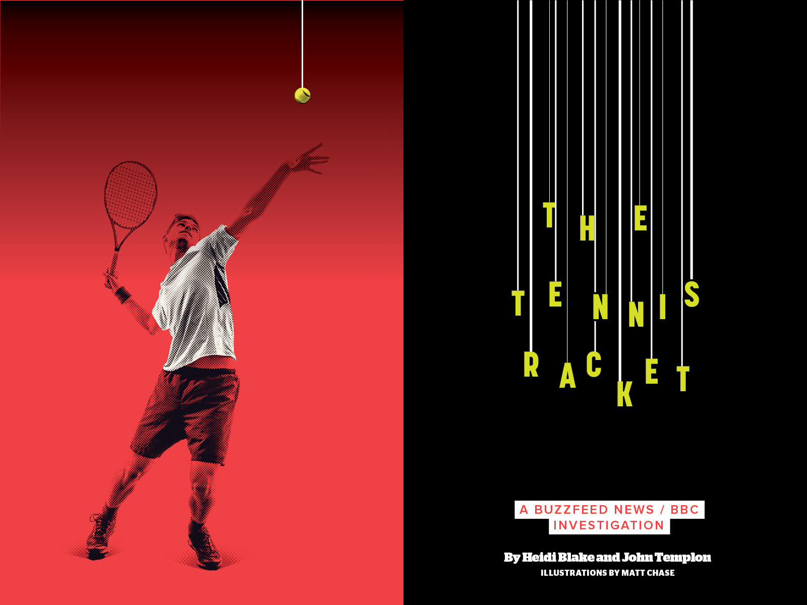
Making A Racket
Notes:
Hi, I’m Heidi Blake, BuzzFeed’s UK investigations editor. It’s such a pleasure to be here and I want to thank the Walkley Foundation so much for inviting me to talk to you all about the ways new technology are shaping the way investigative reporting works.

Slide 2
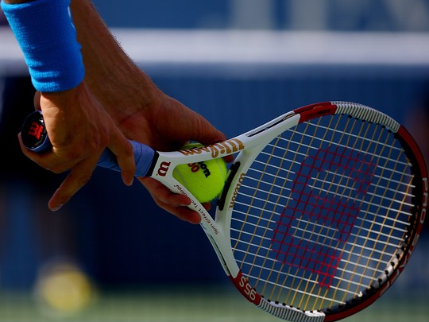

Investigating tennis
A transatlantic reporting partnership
Technological wizardry plus old-fashioned shoeleather journalism

Slide 3


The algorithm
Is based on the scraped the opening and closing odds offered by seven major European bookmakers on 26,000 ATP and Grand Slam matches dating back to 2009
The algorithm detects matches where the pre-play odds shifted by more than 10% against the player who went on to lose — a sign of suspiciously heavy betting
It found 39 players who had lost more than 10 such “high-movement” matches and ran millions computer of simulations to determine the probability that they could have lost naturally on all those occasions

Slide 4

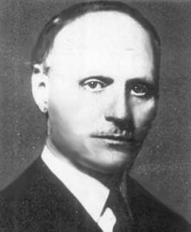
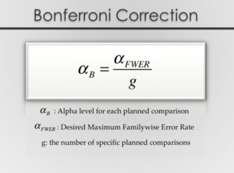
Is this really significant?
Bonferroni Correction
Conservative way of determining significance
Easy to understand results

Slide 5

The results
The algorithm identified 4 players for whom the probability of their losing so many high-movement matches naturally passed the Bonferroni test of statistical significance: the chance of each happening was less than 1 in 1000.
In another 11 cases, there was a less than 5% chance that the players would have lost all those matches through fair play alone.
That made a total of 15 players who were repeatedly implicated in highly suspicious matches.

Slide 6
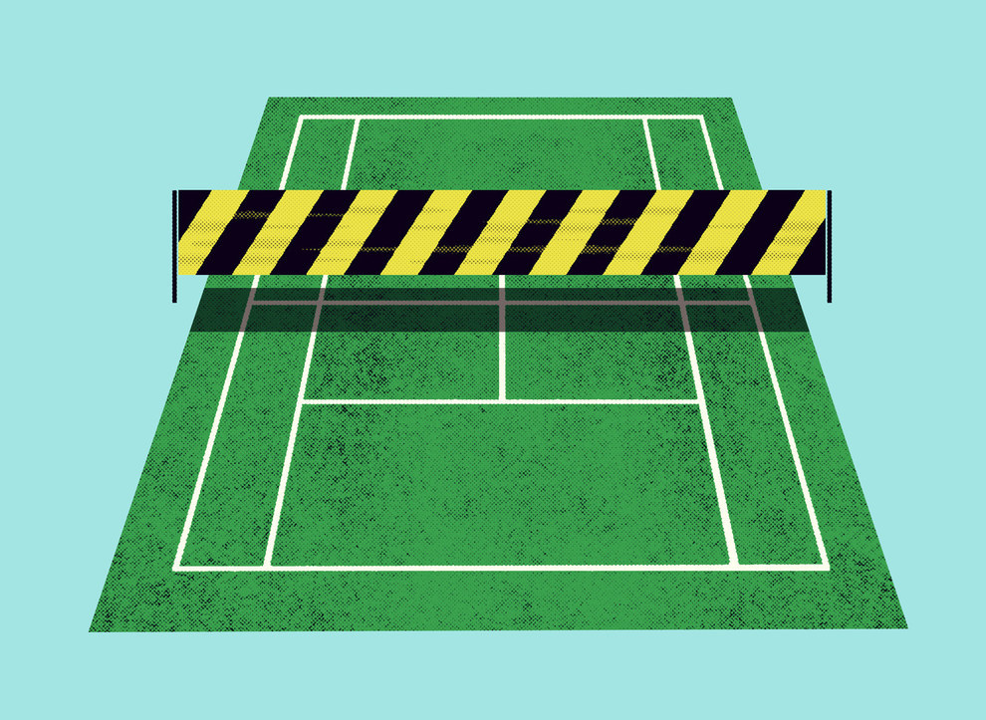
What next?

Slide 7

Sourcing up
In all, we talked to more than 20 gambling industry officials, international police detectives, and sports integrity experts who unanimously told us that world tennis is failing to confront a serious problem with match-fixing

Slide 8

The Fixing Files
Our sources also gave us multiple caches of documents related to previous investigations into match-fixing. Including:
A PowerPoint deck
Multiple reports
Chat logs
Histories of flagged players and matches

Slide 9
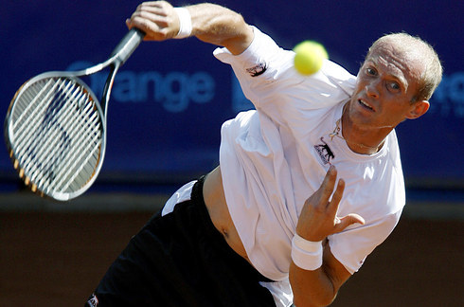
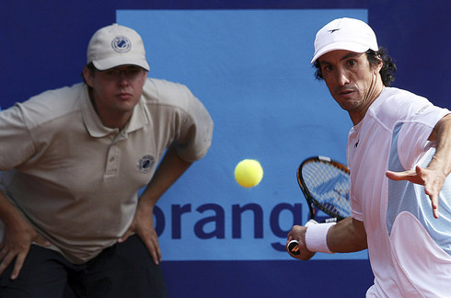
The Sopot match
Tennis engulfed by first match-fixing scandal in 2007 after a notorious match between the Russian world number four, Nikolay Davydenko, and the Argentine no. 87 player Martin Vassallo Arguello
9 Russian accounts bet heavily on Davydenko to lose before the odds went crazy and he retired injured, causing Betfair to void the market

Slide 10
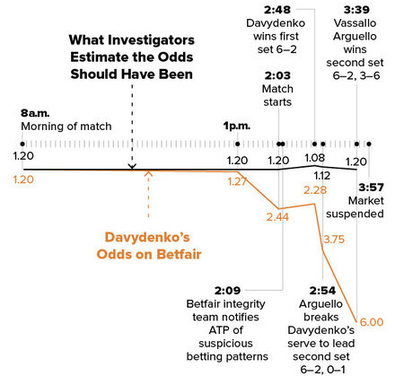

Slide 11

A global match-fixing probe
Review recommended formation of Tennis Integrity Unit, which the authorities accepted
Bill Babcock, head ITF Grand Slam board, declared tennis “healthy” and free of corruption
Team of investigators brought in to probe Sopot match, while two former police chiefs conducted a sweeping review of integrity in professional tennis
Tennis authorities announced no evidence of rule-breaking by Vassallo Arguello or Davydenko at end of investigation

Slide 12
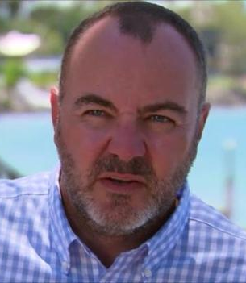
The ATP investigators speak
“They could have got rid of a network of players that would have almost completely cleared the sport up. We gave them everything tied up with a nice pink bow on top and they took no action at all.”
— Mark Phillips, ATP match-fixing investigator

Slide 13
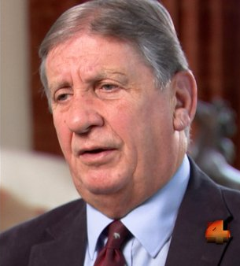
The father of tennis integrity talks
“What they did is a plastic solution which was not effective then and it’s not effective now.”
– Ben Gunn, the founding father of the Tennis Integrity Unit

Slide 14
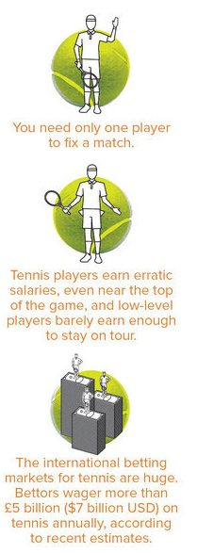

Why is tennis so vulnerable?
“If you were to invent a sport that was tailor-made for match-fixing, the sport that you would invent would be called tennis. It doesn’t take much effort to throw a match without the opponent or the officials or the fans or even the media being aware. Where it does become apparent is in the betting market.”
— Richard Ings, former ATP VP for rules & competition

Slide 15
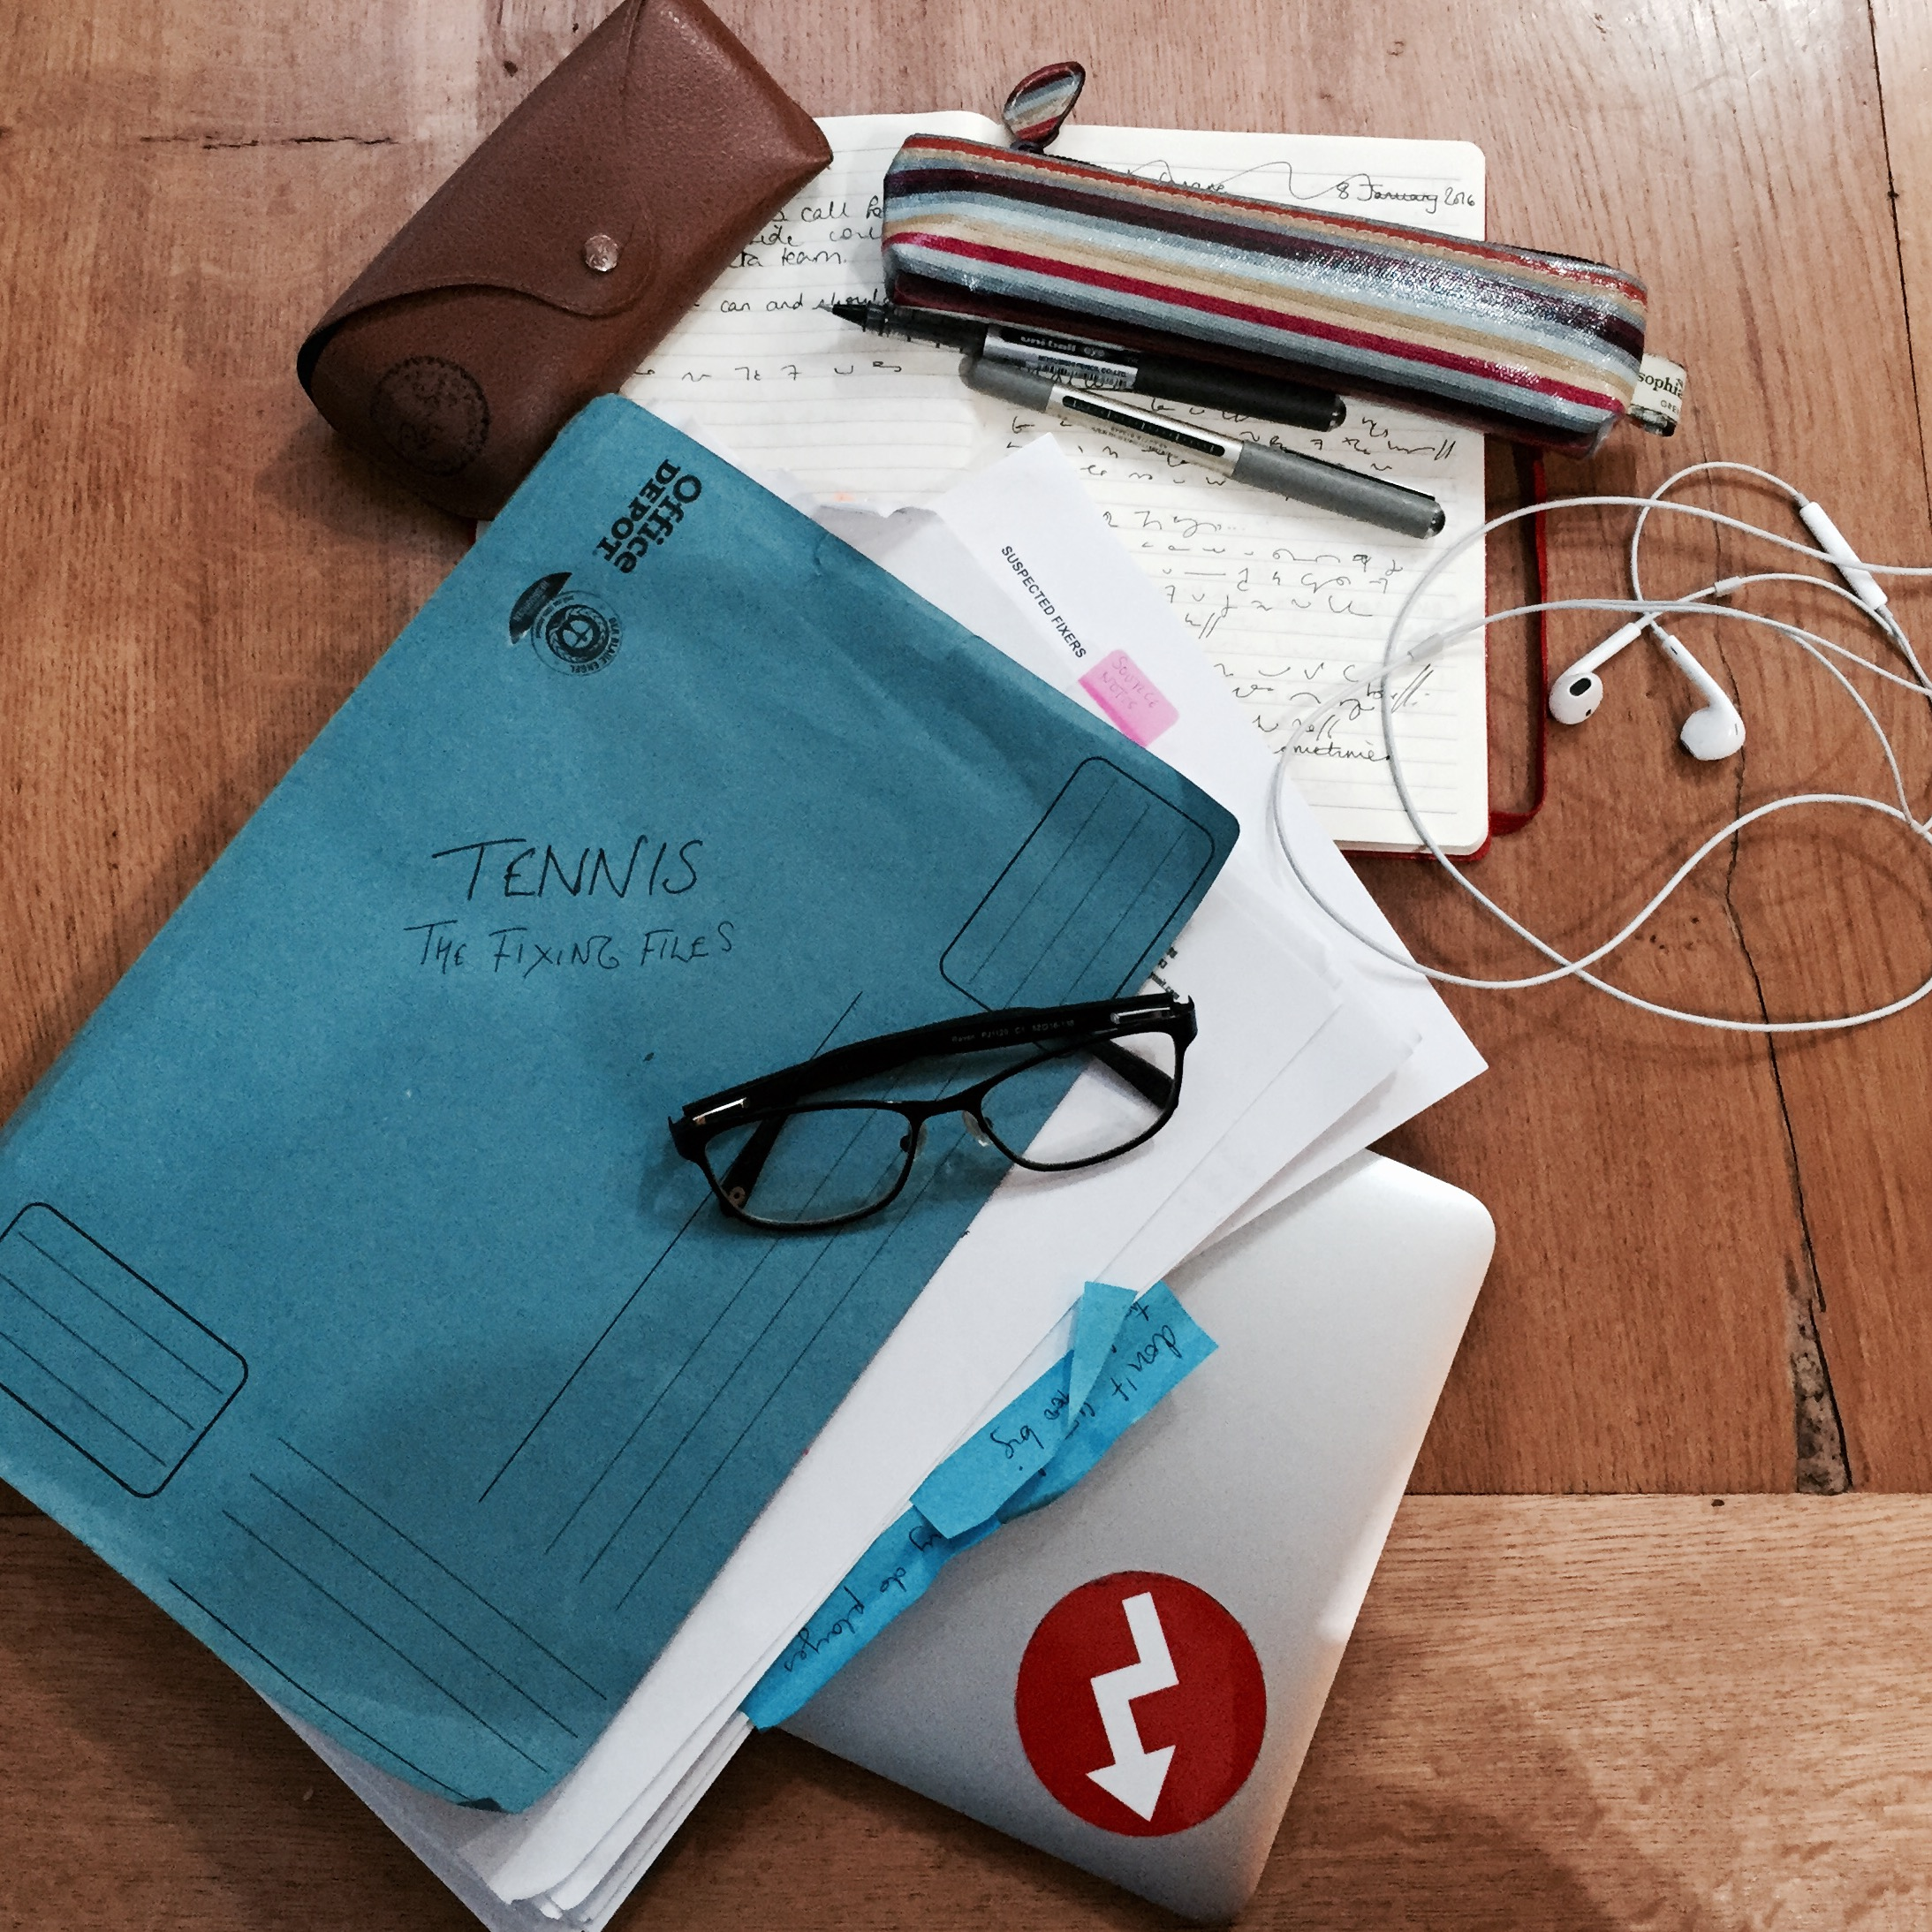
Evidence Ignored
Authorities had since been warned about more than 70 players — and a core group of 16 top players had been flagged again and again, but no action taken.
Eight of the players who had been repeatedly were about to begin competing in the Australian Open
One player had exchanged 82 text messages with the ringleader of an Italian gambling ring that made hundreds of thousands betting on his matches — but faced no action

Slide 16

The Tennis Racket Breaks
British Prime Minister David Cameron called the allegations “deeply concerning” and demanded an urgent investigation, while MPs in the House of Commons announced a parliamentary inquiry
Andy Murray was among first to tweet story and Novak Djokovic admitted he had been offered $200,000 to fix
Roger Federer said the allegations were “super serious” and called for corrupt players to be outed
The governing bodies of world tennis were eventually forced to announce a QC-led independent review of the integrity of the game

Slide 17

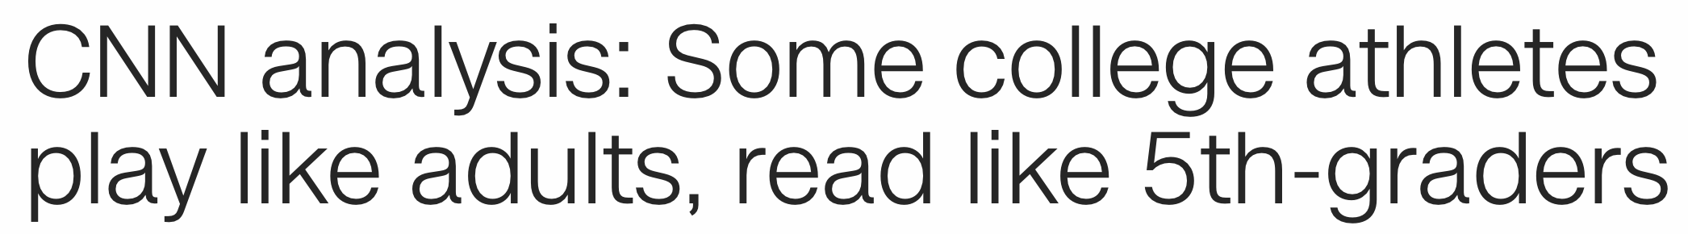
Using Data In Sports Investigations
Notes:
A few examples of sports investigations that have used data in different ways: 1. The Tennis Racket 2. Crossword Plagiarism from 538 3. CNN on the reading level of college athletes

Slide 18

Getting The Data
Who has data?
Regulatory agencies
Betting houses
Leagues
NCAA: http://stats.ncaa.org/
NBA: http://stats.nba.com/
MLB: http://gd2.mlb.com/components/game/mlb/
IAAF: https://www.iaaf.org/
FINA: http://www.fina.org/content/swimming-records

Slide 19
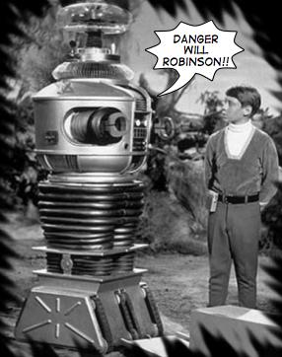
Cleaning Data
Things to look for:
Is the data complete?
Missing columns
Missing values
Wrong type
Are there weird outliers?
One really big or small number
Are the sample sizes really small?
Notes:
I do this work in Python with an analysis package called Pandas. But depending on the size of the dataset you could also do it in Excel or using Google’s OpenRefine.
Excercise: https://data.cityofnewyork.us/Business/Sidewalk-Caf-Licenses-and-Applications/qcdj-rwhu/data

Slide 20

Understanding The Data
Talk to experts
Statisticians
People working in the sport
Former investigators
Notes:
When I’m looking for experts, especially at the beginning of a project, I’ll typically send an initial email explaining that I’m a journalist who is working on a data related project and that I’m hoping to receive some guidance. A few notes about using academic experts:
They’re used to publishing on an academic schedule and may need some pushing.
They think like academics. You’re not publishing a research study. You’re looking for data to start or enhance an investigation. Make that clear.
Not everything they say is going to be understandable to you (or your audience). Push back. Ask questions. Treat them like a source.

Slide 21

Reporting Based On Data
Notes:
Data is often not going to end of an investigation. It can provide a lot of the “What happened,” but almost never the “Why.” Recently multiple studies of the ball in Major League Baseball have shown that the balls are smaller and have flatter seams:
https://fivethirtyeight.com/features/in-mlbs-new-home-run-era-its-the-baseballs-that-are-juicing/, https://theringer.com/2017-mlb-home-run-spike-juiced-ball-testing-reveal-155cd21108bc
But they don’t know why it happened. They best they can do is ask Major League Baseball, who has said that the balls are within the standards generally set for their manufacturers.
Best case? You go report out the data and find even more, like what happened with The Tennis Racket.
Worst case? You have an interesting explanatory, but not necessarily investigative sports story.

Slide 22
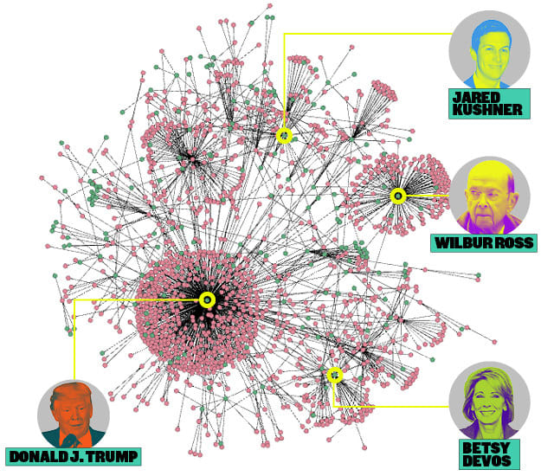
Think About Data Non-Traditionally
Data isn’t always numbers in a spreadsheet.
Other types:
A list of events
A timeline
A network diagram
Notes:
For instance in the Tennis Racket we had a spreadsheet of all the match-fixing investigations we were ever told about and the players that were related to each investigation. That helped us eventually nail our lead that: The sport's governing bodies have been warned repeatedly about a core group of 16 players – all of whom have ranked in the top 50 – but none have faced any sanctions and more than half of them will begin playing at the Australian Open on Monday.

Slide 23
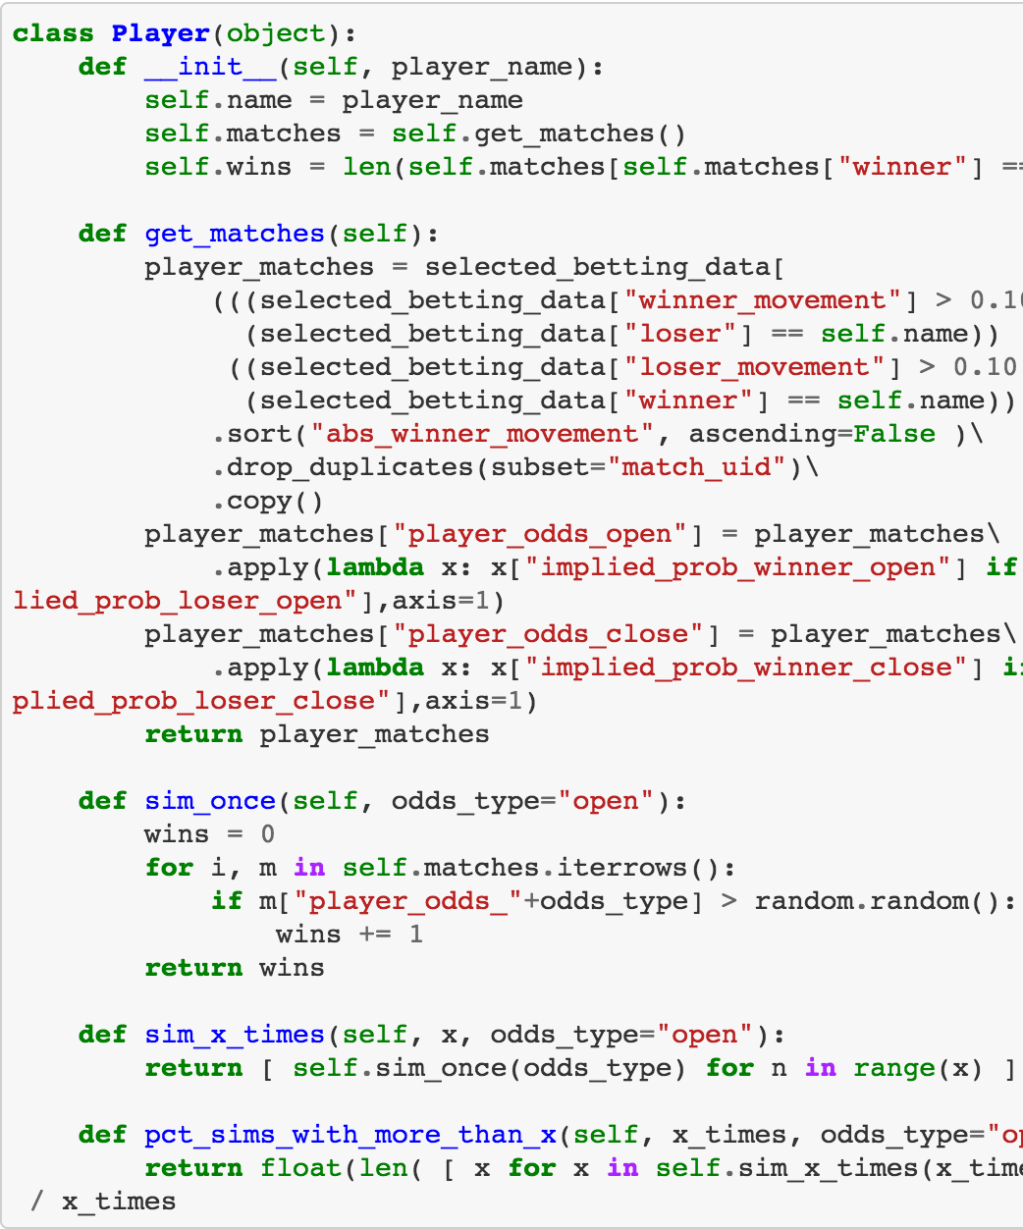
Transparency In Data Analysis
When we do investigations we publish whatever data and code we are able to (typically on Github).
For The Tennis Racket we published the code and a separate methodology post.

Slide 24

Getting Data Part II
Ask nicely
Scrape it
Open records
Notes:
If you’re in a country (area) with strong open records laws you should really think about how data touches the government some ideas:
A. Ownership
B. Regulatory
C. Building stadiums
D. Contracts

